Slide 1

GudSpot
Team - 3 Intro to software engineering

Slide 2
Team members
ID | Name | Role
19127183 | Dương Minh Khôi | Team leader
19127072 | Nguyễn Năng Tiến | Front-end developer
19127356 | Nguyễn Tiến Đạt | Front-end developer
19127177 | Nguyễn Đăng Khoa | Back-end developer
19127358 | Nguyễn Trọng Đạt | Back-end developer

Slide 3
Problem
The problem of
Affects
traveling alone at new places, sick of going old places
business owners and traveler
Impacts
Solution
allows users an opportunity to advertise their business
customer’s lack knowledge of entertainment spots while good entertainment spots are underrated or unnoticed.
Notes:
Solution: (food, fashion, drinks,...) to people through posting images, writing blogs, interacting with customers through chat, comment,...

Slide 4
Product position
For: youngsters, backpackers
Who: loves to travel alone to new places
People
Is a web application help its users to find the most suitable place for them to have fun, eat,... faster.
GudSpot
Unlike currents website Foody, Grabfood,... Our product connect business owners with tourists, highlighting local attractions.
Differences

Slide 5
Markets
Customers
Youngsters who loves traveling and trying new places
Owner
New startup need place to advertising
Size
It’s medium where youngsters take 23,8% of the Vietnamese population
View
Be one of the most popular web in this market

Slide 6
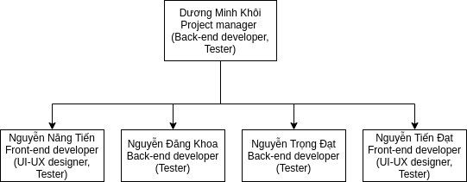
Team Structure

Slide 7
Responsibilities
Khôi
Tiến
Create friendly UX/UI and call API
Lead the team, keep the teams on tracks to final goal
Khoa
Everyone
Design, create, control and maintain databases
Testing and analyze each components and database when finish
Trọng Đạt
Tiến Đạt
Create API to connect between databases and UI
Create friendly UX/UI and call API

Slide 8
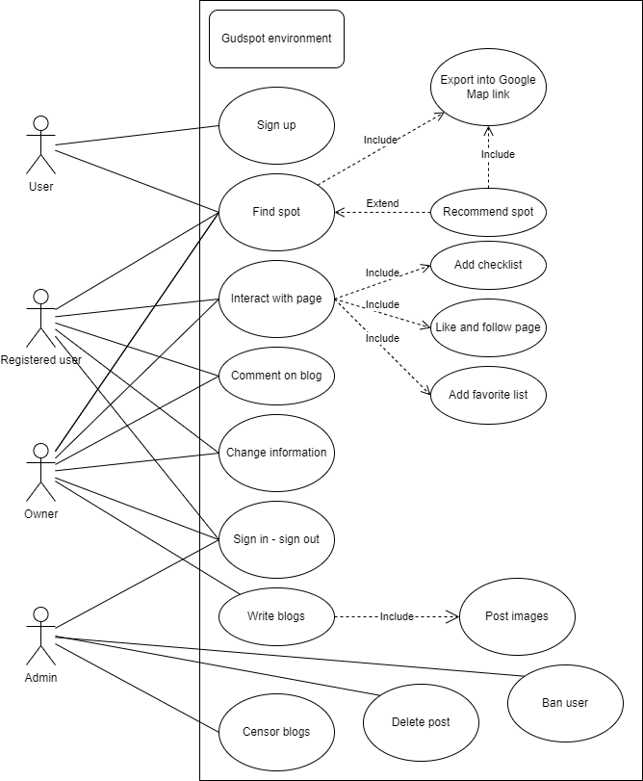
User-case model

Slide 9
Requirements
UI
Popularity
Lightweight website
Responsive
Elegant, intuitive UI/UX
High
Spots
Data
Diverse
Appropriate
Secured
Age
Maintenance
Able to user by any user
Smooth

Slide 10
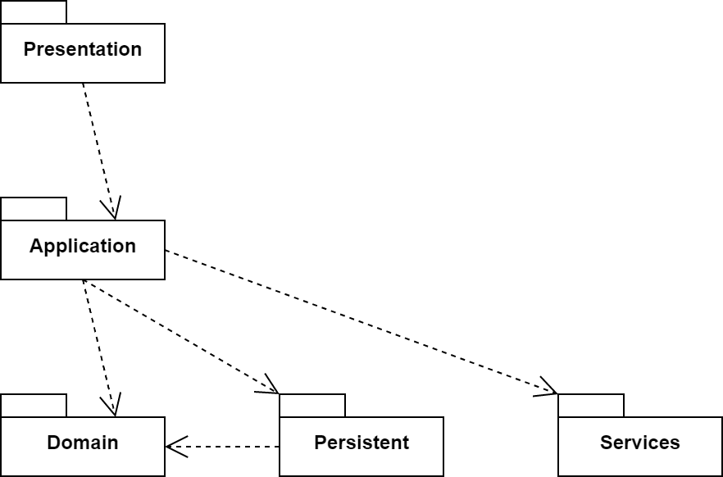
Architecture

Slide 11
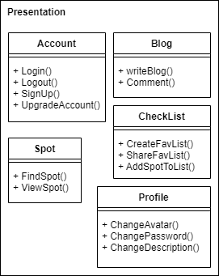
Presentation

Slide 12
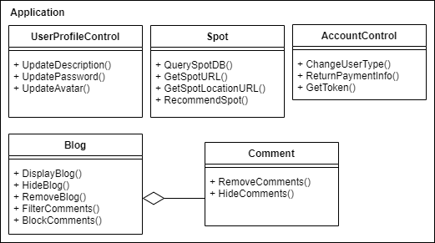
Application

Slide 13
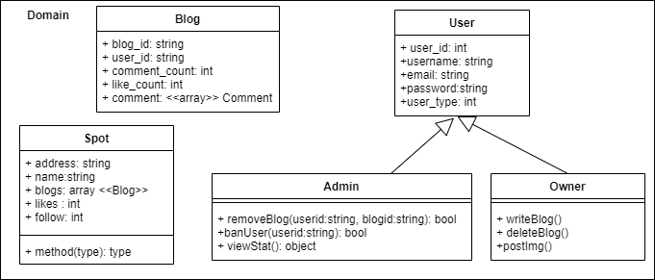
Domain

Slide 14
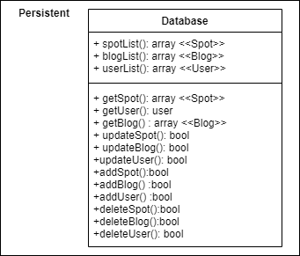
Persistent

Slide 15
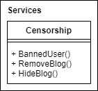
Services

Slide 16
Software testing
Hardware and Software
What to test
What are the results ?
Environments
Test Plan
Test result

Slide 17
Test environments
Internet Browser
Operating System
Firefox
Chrome
Microsoft Edge
Mac OS
Windows
Android
IOS

Slide 18
Test plan
API testing
System
End to end
Test Manager
Tester
Use case
Non-functional
Testing all use cases of GudSpot
Reliability
Security
Consistency
Functional
Responsibility

Slide 19
Test results (Some of them)
Title | Description | Severity | Status
Unexpected maximum length for blog title | The maximum length of the blog title was set to 200 in the model. In the test case, the number of characters of the title was 201 and the system still accepted the data. Actual maximum length is 215. | Medium | Open
Login randomly | When login with username: "" and pwd: "" the website the user login with random account | High | Close

